Slide 1
FY21 PROJECTED PROFITABILITY ANALYSIS
College of Music and Media,
LOYOLA UNIVERSITY, NEW ORLEANS

Slide 2
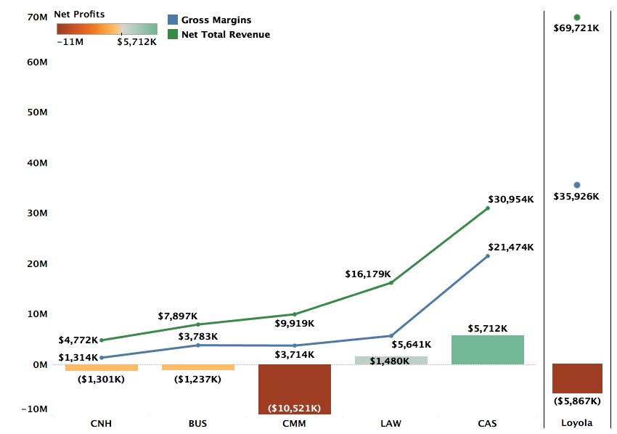
Profitability by College FY21 Projections

Slide 3
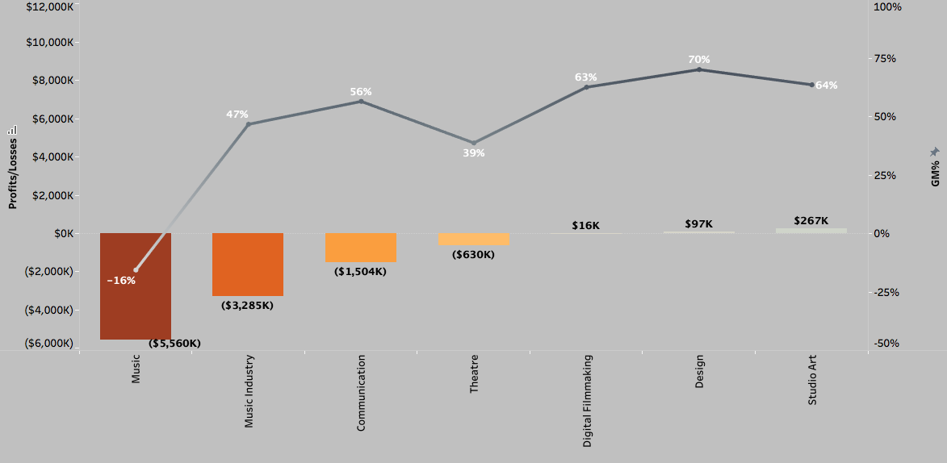
Profitability and GM% by Department (FY21 Projections)
Excluding Environment

Slide 4
DEFINITIONS
Total Revenue (TR): TR includes revenue for courses taught by the faculty of a department across all three terms, distributed revenue for courses that do not belong to a specific department, and distribution of revenues from courses of programs like Study Abroad that do not have any assigned faculty.
Avg. TR per credit (FY20) for Fall and Spring semesters is $577
Gross Margins (GM): GM = TR – Direct Costs. Direct costs include salaries, operating costs, and fringe benefits.
Avg. GM% for FY20 = 54%
Profitability = GM – Indirect Costs + Indirect Revenues. Indirect costs refer to administration costs, auxiliary costs, or college level costs distributed over departments of the specific college. Indirect revenues include auxiliary revenues, dorm revenues, and revenue from other sources.

Slide 5
Methodology FY21 Projections
FY21 Revenue Projections: Revenue projections are based on Fall 2020 enrollments and projected Spring retention rate. FY20 summer revenues are used as proxy for the FY21 summer term.
Direct Costs: Direct costs include salaries and operating costs from department budgets. FY20 fringe benefits are used as a proxy for FY21 fringe benefits.
Indirect Costs: Indirect costs in FY20 and FY21 have been higher than previous years and is reflected in department-level profitability. FY21 is also estimated to bring in lower Auxiliary revenues.

Slide 6
DEPARTMENTS WITH WORSENING FINANCIAL PERFORMANCE

Slide 7
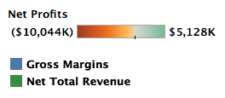
Music
Music has high enrollment but also a historically high discount rate which suppresses their TR.
Music also has twice the directs costs of an average department which further suppresses their GM% to -18% (FY20) and -16% (FY21).
GM% for Music was negative in FY20 due to a steep decline in TR without proportional cuts in direct costs. The steep decline in TR was driven by high discount rate as evidenced by TR/Credit of $387 compared to university average of $577 and is only seeing a slight recovery in FY21.

Slide 8
Music Industry
The TR/Credit for Music Industry decreased from $698 in FY19 to $519 in FY20 signifying high discount rates as drivers of low revenues, despite increase in # credits from FY19 to FY20
The FY21 GM for Music Industry is 47% compared to the university average of 55%
Increased auxiliary costs and reduced auxiliary revenues because of COVID-19 add to the projected losses in FY21 but the structural issues of high discount rates that have driven losses historically persist
Notes:
NTR and GM for Music Industry are projected to continue to decline in FY21 because of combination of lower enrollment and higher discount rates – what is the NTR/student by year?

Slide 9
Theatre
The projected GM for Theatre is 39%, 15 percentage points lower than the university average
Theatre’s low GM is being driven by high discount rates. TR/Credit of $471 in FY19 and $425 in FY20 compared to the university average of $594 and $577 in both years respectively
Projected increases in auxiliary costs and simultaneously declining auxiliary revenues because of COVID-19 add to the department’s losses

Slide 10
Communication
Communication had an a slight increase in NTR from FY19 to FY20 but is projected to see a ~11% decline in FY21 due to lower enrollment
GM of 56% is only slightly higher than the avg of 54%, but is weighed down by indirect costs given the department’s size

Slide 11
PROFITABLE DEPARTMENTS

Slide 12

Digital Filmmaking and Studio Art
Digital Filmmaking
Studio Art

Slide 13
Design

Slide 14
Appendix (FY19 and FY20)

Slide 15
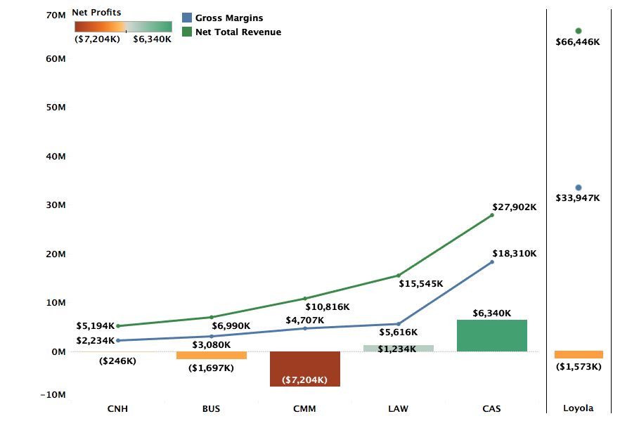
Profitability by College FY20 Actuals

Slide 16

Profitability and GM% by Department (FY20 Actuals)
Notes:
Accounting is projected to be positive. All other 14 departments continue to be loss making. – Add the note on Accounting

Slide 17
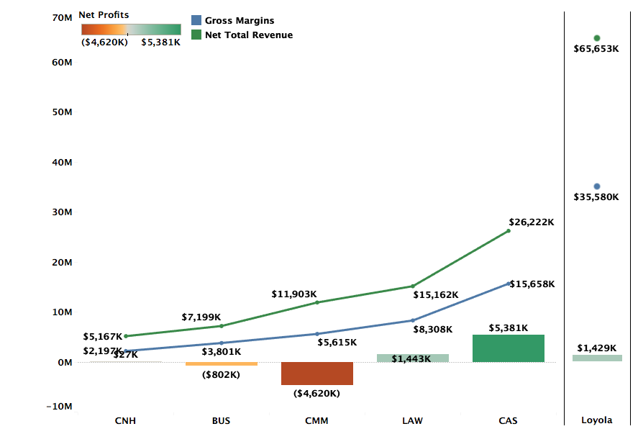
Profitability by College FY19 Actuals

Slide 18
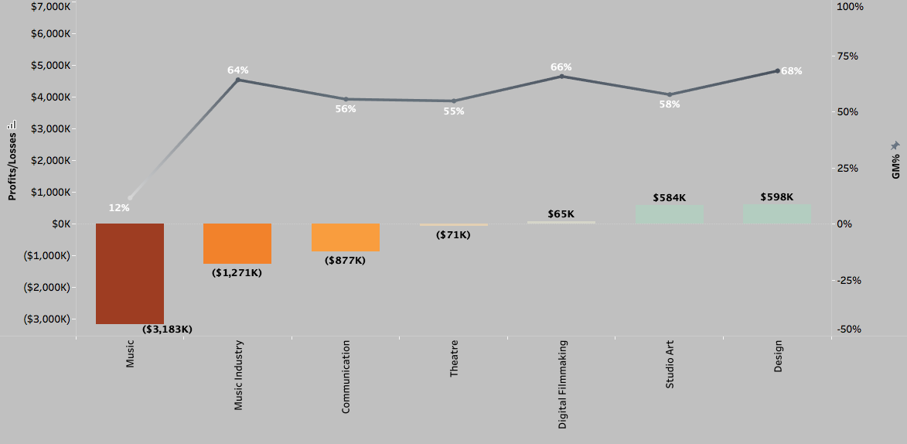
Profitability and GM% by Department (FY19 Actuals)

